Slide 1


Our Changing Climate: Climate change
© 2020 Johns Hopkins University

Slide 2

Weather vs. Climate
The temperature in New York City averaged 82 degrees Fahrenheit on July 20, 2010.
The temperature in New York City averaged 77 degrees Fahrenheit for the month of July between 1981 and 2010.
Photo Credit: Anthony Quintano. Flickr. Creative Commons CC BY 2.0.

Slide 3
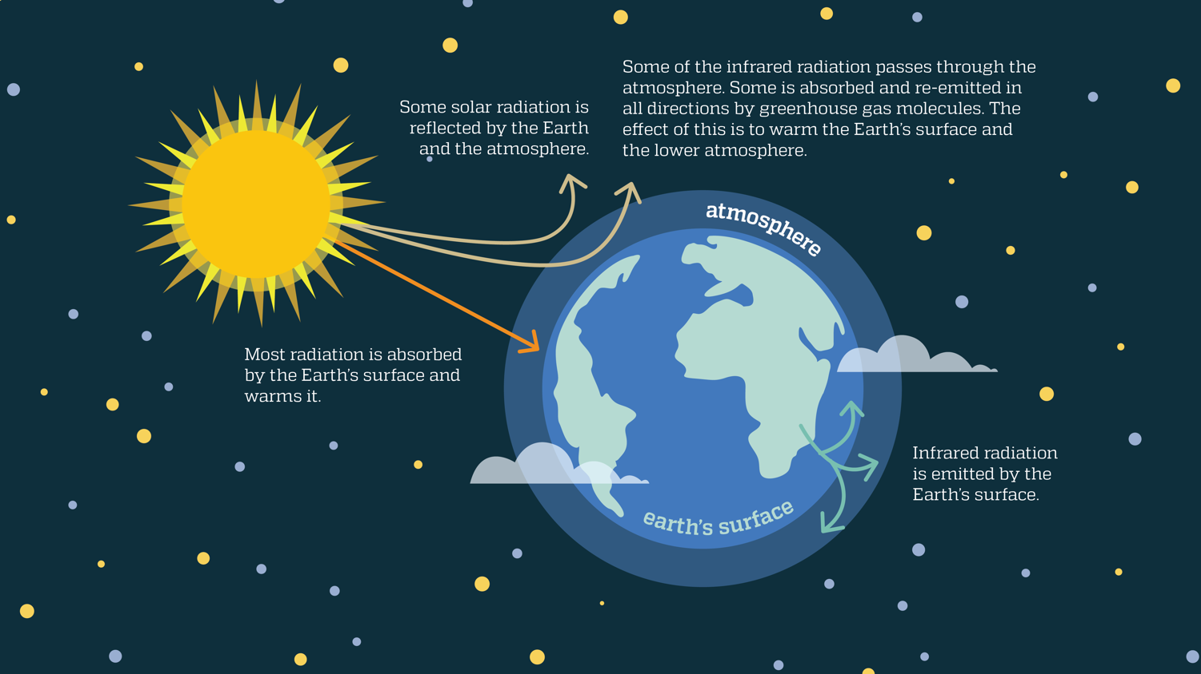
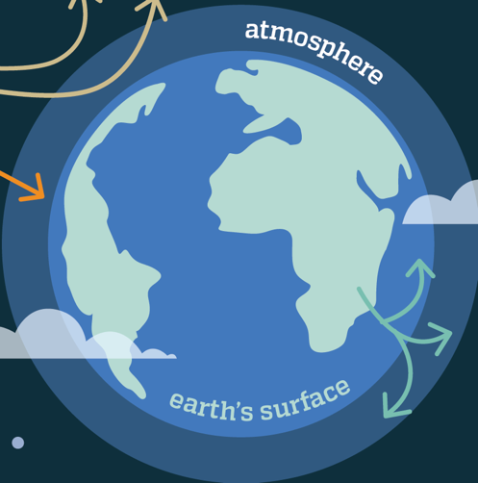
The Greenhouse Effect
Adapted from: US EPA. Climate Change Indicators in the United States, 2014. 3rd edition. Washington, DC. http://www.epa.gov/climatechange/science/indicators/download.html

Slide 4
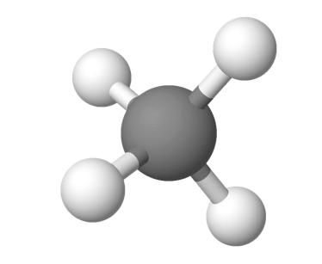
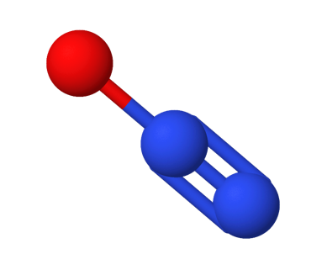

Sources of Greenhouse Gases
H
H
N
C
Methane
N
Nitrous oxide
H
Source | Green House Gas or Gases
Decomposition of food waste in landfills | Methane, nitrous oxide
Use of nitrogen-based fertilizer on crops | Nitrous oxide
Transporting food products | Carbon dioxide, nitrous oxide, methane
Bacterial decomposition in rice paddies | Methane, nitrous oxide
Livestock manure | Methane, nitrous oxide
Clearing forests for farmland | Carbon dioxide
Cattle belching | Methane, carbon dioxide, nitrous oxide
Running agricultural machinery | Carbon dioxide, nitrous oxide, methane
O
H
O
C
O
Carbon dioxide

Slide 5
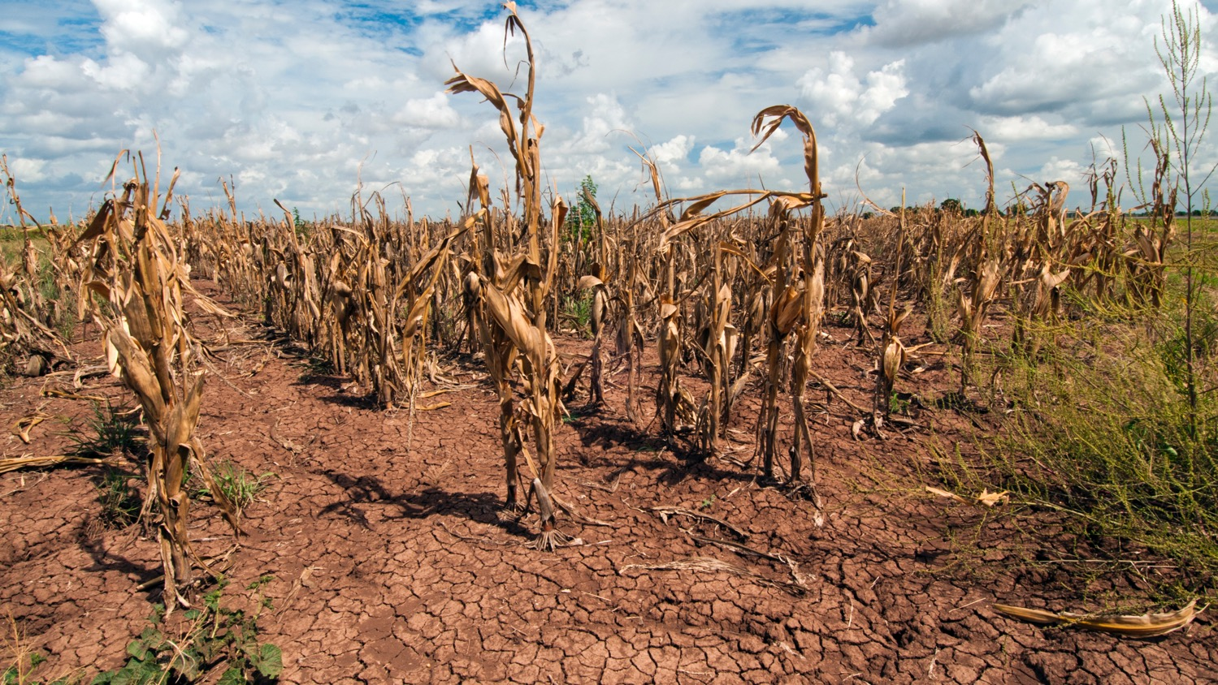
Drought
Photo credit : Bob Nichols, 2013. Texas drought affecting corn crops. USDA. Creative Commons CC BY 2.0.

Slide 6
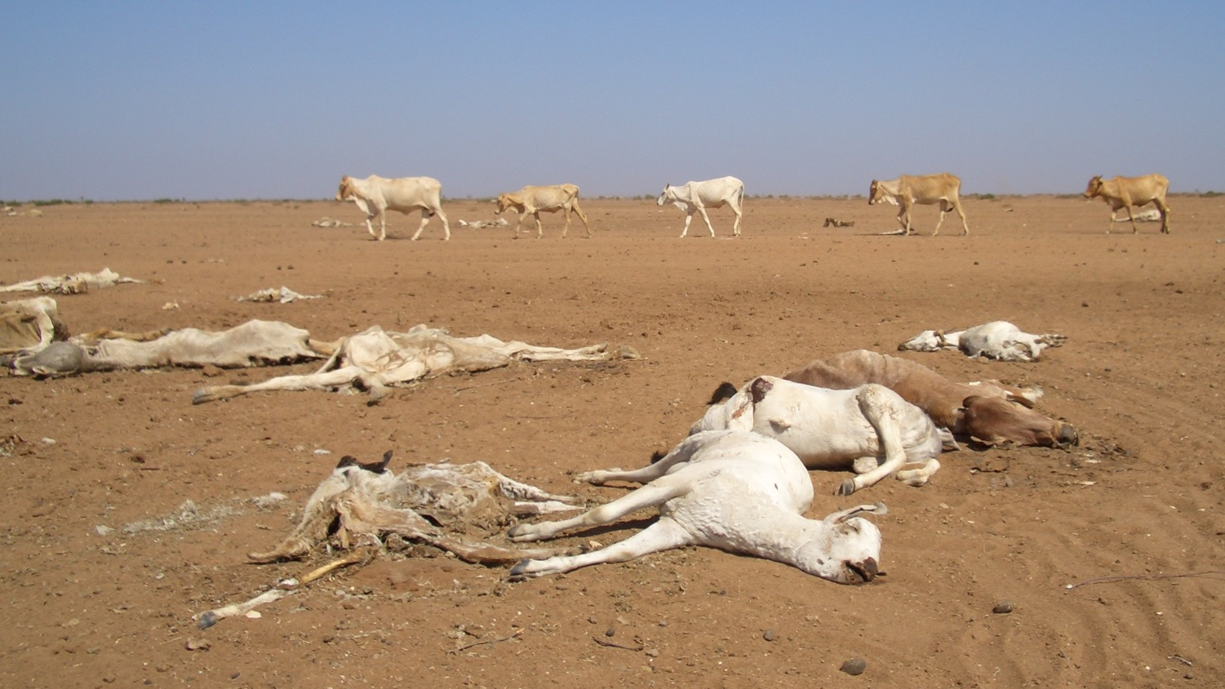
Climate Change Impacts on Agriculture
Loss of topsoil
Fungus invasion in corn crop
Saltwater contamination of freshwater supply
Increased cost to fight weeds
Increase in a crop’s water needs
Higher food prices
Depletion of freshwater sources for irrigation
Photo credit: Brendan Cox, Oxfam International, 2004. Creative Commons CC BY-NC-ND 2.0.

Slide 7
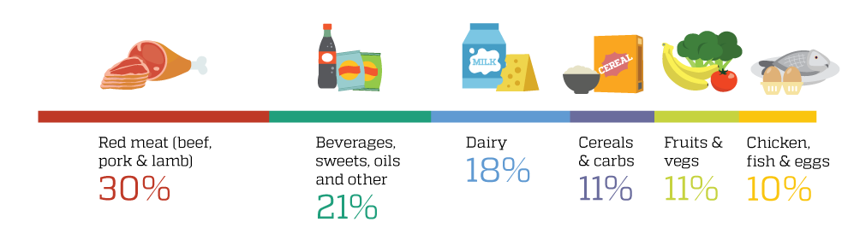
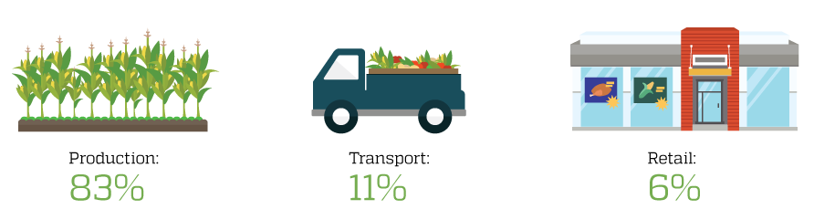
Food System Greenhouse Gas Emissions
U.S. GHG emissions by food type
U.S. GHG emissions by supply chain stage
Data source: Weber CL, Matthews HS. Food-Miles and the Relative Climate Impacts of Food Choices in the United States. Environ. Sci. Technol. 2008, 42 (10), 3508–3513.

Slide 8
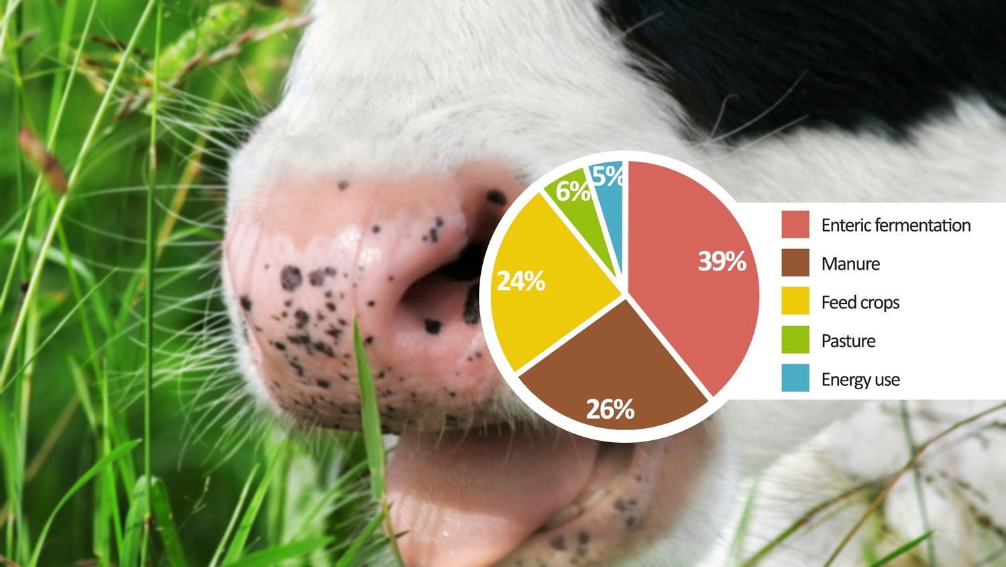
Livestock Greenhouse Gas Emissions
Livestock are responsible for 15% of global GHG emissions from human activities – more than transportation
39% of livestock’s GHG emissions are from enteric fermentation, a digestive process that produces methane
Cattle release most of the methane through belching
Data source: Gerber PJ, Steinfeld H, Henderson B, et al. Tackling Climate Change through Livestock – A Global Assessment of Emissions and Mitigation Opportunities. Rome: FAO; 2013.

